Slide 1
Parallel Programming in Python – a very, very short introduction
Agenda
Computer architectures, data structures, and opportunities
Case 1 – computing a distance matrix
Case 2 – computing the average of a large sample

Slide 2
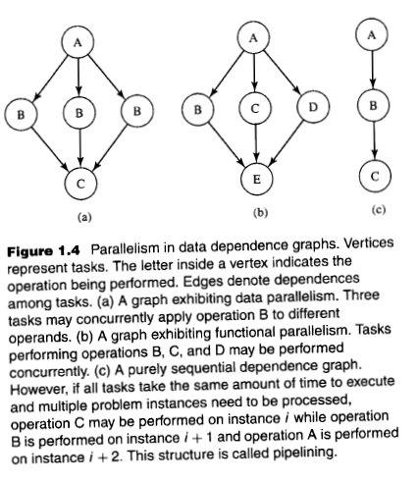
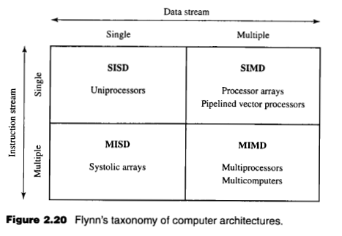
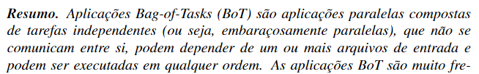


The scope of the technique that will be presented:

Slide 3

Case 1 – computing a distance matrix

Slide 4
Case 1 - computing a distance matrix, sequential scheme
d-dimensional vectors
v1
v2
v3
vk
v1
v1
v1
v1
v2
v2
v2
v3
v3
tasks
v2
v3
vk
v3
vk
vk
vk
v1
v2
v3
vk
v1
0
Sequential execution, process P1
v2
0
v
distance matrix
v3
0
0
vk
v
0
distance matrix

Slide 5
Case 1 - computing a distance matrix, parallel scheme
d-dimensional vectors
v1
v2
v3
vk
v1
v1
v1
v1
v2
v2
v2
v3
v3
tasks
v2
v3
vk
v3
vk
vk
vk
v1
v2
v3
vk
v1
0
Parallel execution
process P1
Parallel execution
process P2
v2
0
v
distance matrix
v3
0
0
vk
v
0
distance matrix

Slide 6
Case 1 - computing a distance matrix, sequential scheme
Photo + link to commented video

Slide 7
Case 2 – computing the average of a large sample

Slide 8

Case 2 - computing the average of a large sample, sequential scheme
Attributes obtained from the same individual
(sample)
height
weight
Sequential execution, process P1
$$BMI=\frac{weight}{{height}^{2}}$$
BMI

Slide 9
Case 2 - computing the average of a large sample, parallel scheme
Attributes obtained from the same individual
(sample)
height
weight
Parallel execution
process P1
Parallel execution
process P2
Parallel execution
process P3
Parallel execution
process P4
$$BMI=\frac{weight}{{height}^{2}}$$
BMI

Slide 10
Case 2 - computing the average of a large sample, statistical scheme
Attributes obtained from the same individual
(sample)
height
weight
Sequential execution, process P1
$$BMI=\frac{weight}{{height}^{2}}$$
BMI

Slide 11
Case 2 - computing the average of a large sample, statistical scheme
Photo + link to commented video

Slide 12
Case 3 – TBD

Slide 13
To be resumed in a future meeting ;)

Slide 14
Parallel Programming in Python – a very, very short introduction
Thanks!

Slide 15
Parallel Programming in Python – a very, very short introduction
References

Slide 16
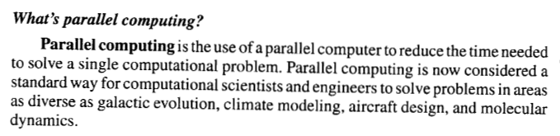
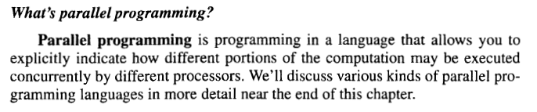

Slide 17
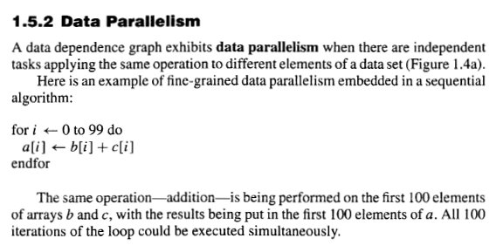
Bag of Tasks

